Slide 1
Portal Advanced Features
Sites, Layouts, Navigation, Portlets

Slide 2
Sites
Site creation and URLS

Slide 3
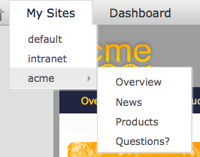
Sites
You can manage several sites in eXo.
By default, there 3 example sites “acme”, “intranet”, “default”.
Each site consists of a navigation nodes (=menu entries), pages and a common site layout.
The site acme has the navigation entries “Overview”, “News”, “Products”, “Questions”.
Navigation nodes of the site “acme”
Available sites
Notes:
3

Slide 4
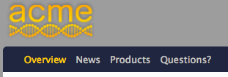
Sites
The site layout defines the layout of the common part of all pages of a site. Normally there are a common header and common footer.
In this example the current site is is called “acme”.
The different pages are opened by clicking on the navigation nodes “Overview”, “News”, “Products”, “Questions” which opens the corresponding pages.
Later on, we will see how navigation nodes and pages are logically separated.
Navigation of the site “acme”
Notes:
4

Slide 5
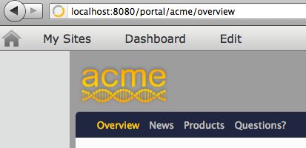
Sites
The URL is composed of the current site and the chosen navigation node.
Choose navigation node “Overview”
The URL reflects the current site and the chosen navigation node
Current site
Notes:
5

Slide 6
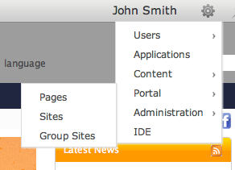
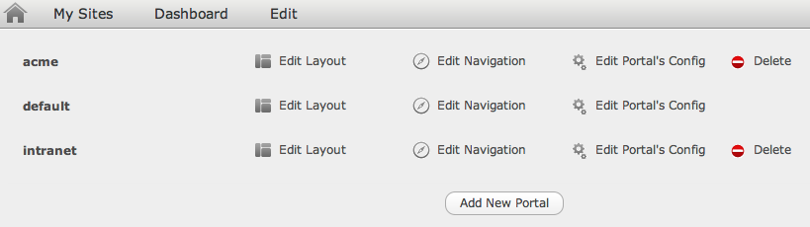
Manage your Sites
1. Click
You can manage several sites.
Sometimes the terms “site” and “portal” are interchanged.
Each site has it’s own layout, navigation, pages and properties.
You cannot delete the default site
2. Create a new site
Notes:
6

Slide 7
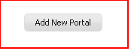
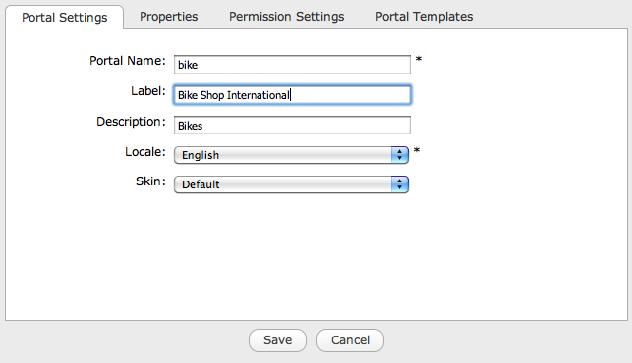
Manage your Sites
Click on “Add New Portal” and choose a name, locale and skin for your site.
The name appears in the URL and cannot be changed.
The label is used elsewhere.
Notes:
7

Slide 8
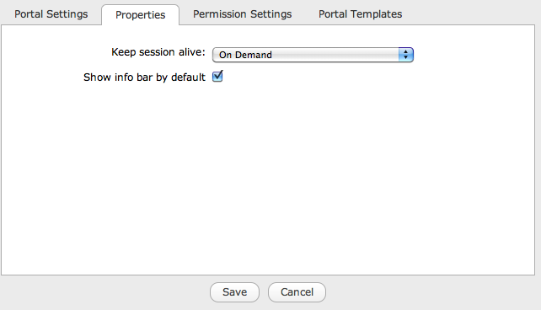
Manage your Sites
Check if you generally need decorations around the portlets. 95% of the customers do not need this.
Notes:
8

Slide 9
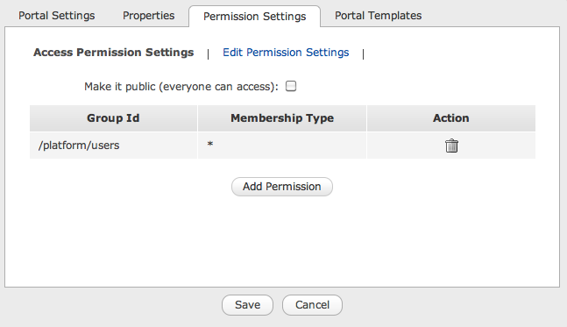
Manage your Sites
Access and Edit Permissions.
Add more groups that will have access permission.
Notes:
9

Slide 10
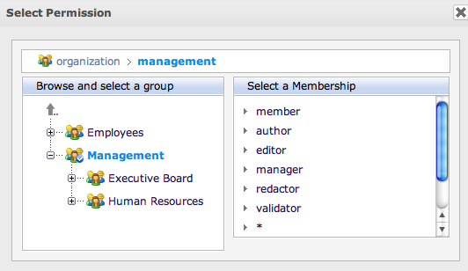
Manage your Sites
Permission Selector.
Notes:
10

Slide 11
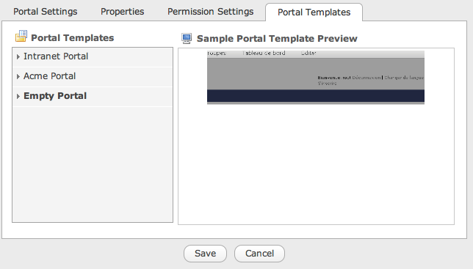
Manage your Sites
Site Templates
Three templates by default. This list can be extended.
Notes:
11

Slide 12
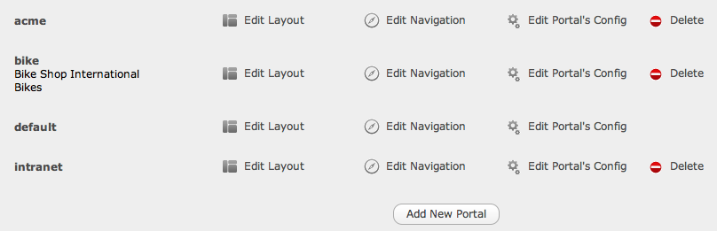
Manage your Sites
The new site appears in the template list.
Notes:
12

Slide 13
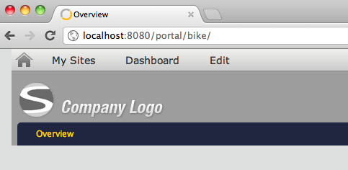
Manage your Sites
After recharging the page it will also be accessible in the admin tool bar.
The URL contains the name of the site
Notes:
13

Slide 14
Exercise: New Site (15 min)
Create a new Site and manage its permissions
Login as John.
Click on Manage Sites in the Admin Tool Bar and add a new site (or portal) called “bike”.
Allow access to everyone. Gives edit rights anybody in the group “platform/users”. (platform/Visitors)
Choose the “Acme Portal” template.
Save.
Warning: Careful, by misadventure you might exclude yourself from your new site: For example, give the edit rights to “platform/bike” only. If you are not part of this group you will not see the new site in the “Manage Sites” interface anymore – in order to see the site again you have to add your user to the group.
Notes:
14

Slide 15
Layout
For Sites and Pages

Slide 16
Site Layout
There a several different pages on a site. Each page has its own URL.
The site layout defines the layout of the common part of all pages of a site. Normally there are a common header and common footer.
A layout consists of a set of containers and applications.
The layout of a single page consists of the headers and footers of the site layout together the page layout.
Notes:
16

Slide 17
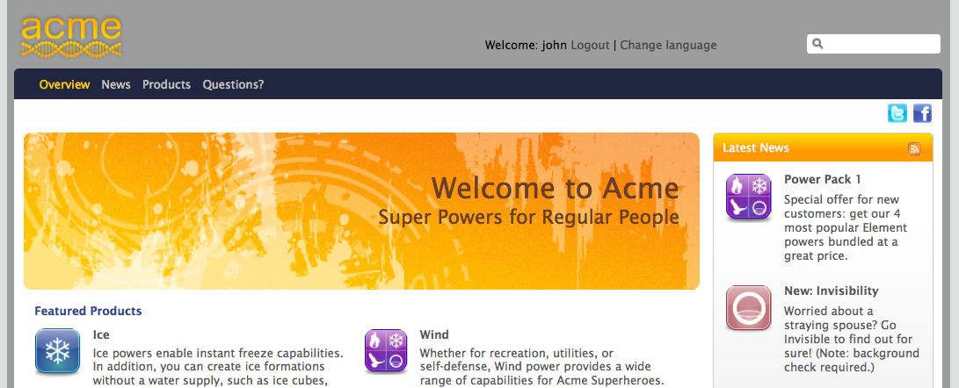
Site Layout
Common header layout of all pages of the site “acme”
In blue color: Layout of the page “Overview”
Notes:
17

Slide 18
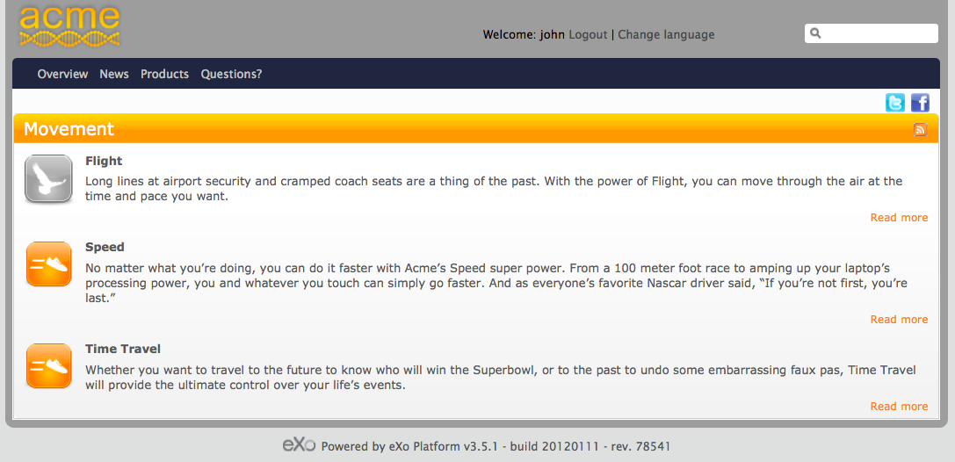
Site Layout
Common header layout of all pages of the site “acme”
In blue color: Layout of the page “Products” (Showing Movement)
Common footer layout of all pages of the site “acme”
Notes:
18

Slide 19
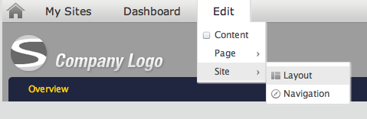
Site Layout
Edit the common layout of all pages of the current site
Notes:
19

Slide 20
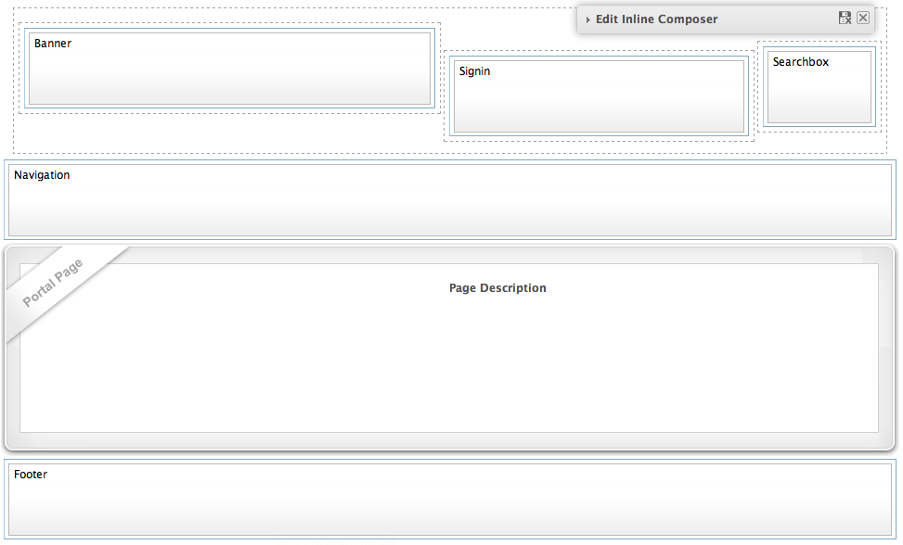
Site Layout
Position of the page.
Notes:
20

Slide 21
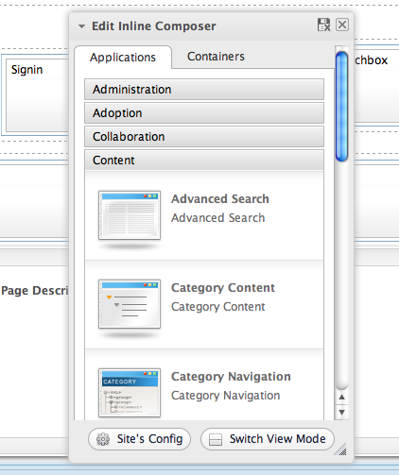
Applications
Organized in categories
Configurable in the application registry (later chapter).
Drag and drop an application from the page editor to the page: In that moment you create a new instance of the portlet.
The page editor shows an applications and a containers tab. Clicking on these tabs switches also the between an application and a container mode.
Categories
Applications
Notes:
21

Slide 22
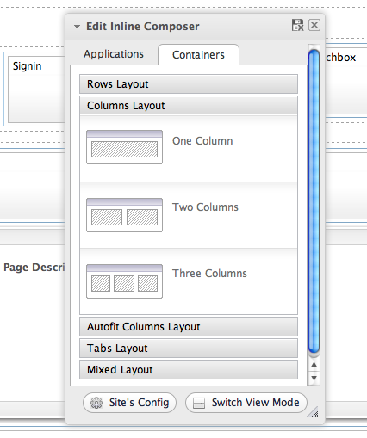
Containers
Containers help to position elements on the page.
Most containers are invisible in the final page.
You can use them in :
Page layout
Portal layout
You can combine different containers.
Notes:
22

Slide 23
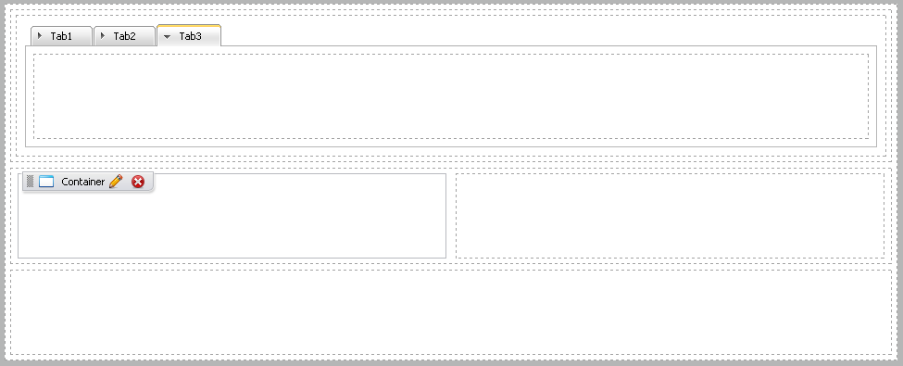
Containers
Container combination
Notes:
23

Slide 24
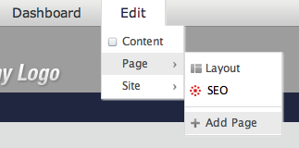
Add a new Page
Add a new page
Notes:
24

Slide 25
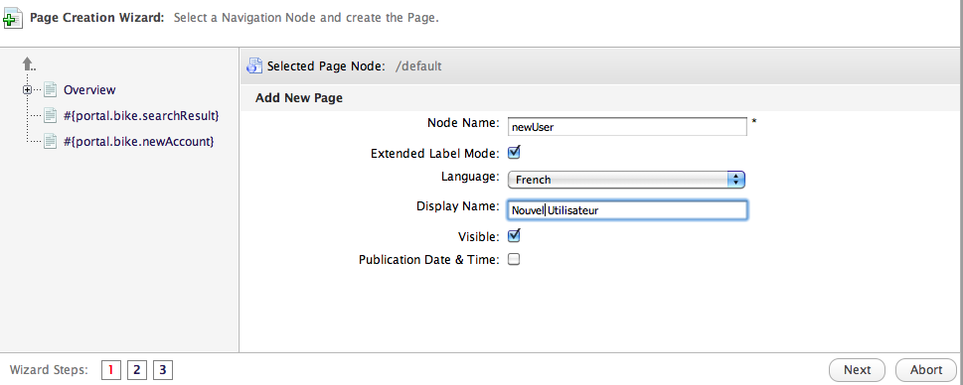
Add a new Page
Click on the arrow until you are and the root navigation node called “/default”.
Add a new page
Multilanguage Labels
Invisible pages do not appear in the menu, they are useful for search results or print viewers.
Notes:
25

Slide 26
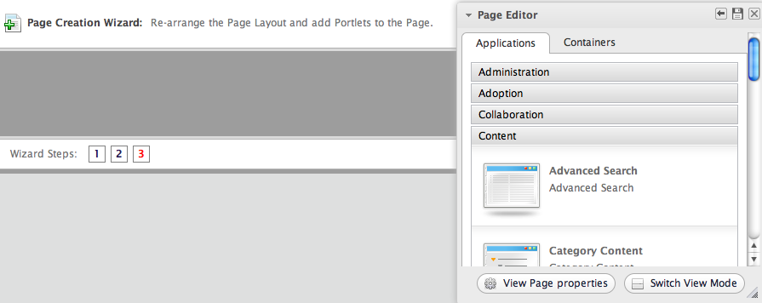
Add a new Page
Add a new page
Notes:
26

Slide 27
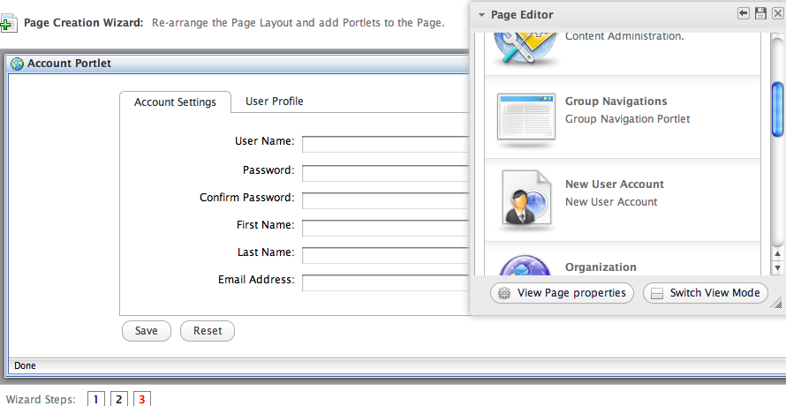
Add a new Page
Add a new page
Notes:
27

Slide 28
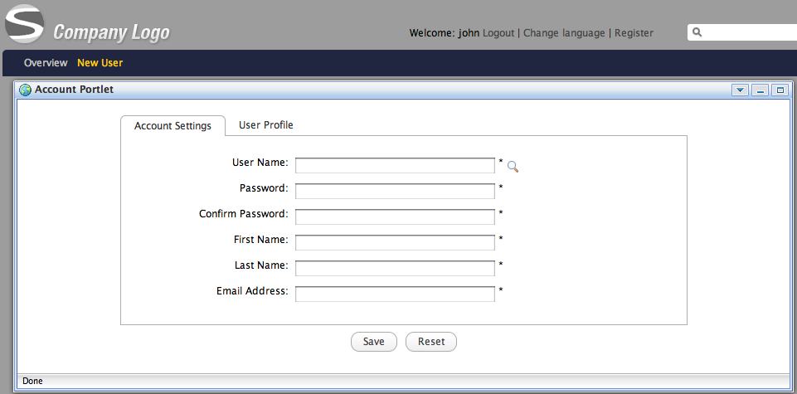
Add a new Page
Add a new page
Notes:
28

Slide 29
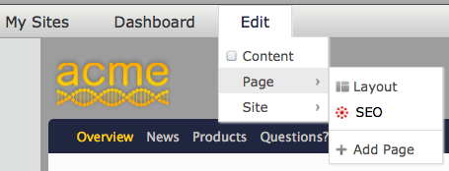
Page Layout
Edit the layout of the current page
Notes:
29

Slide 30
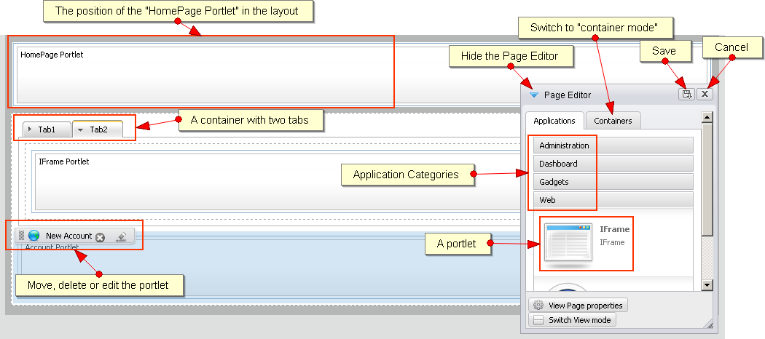
Page Layout
Notes:
30

Slide 31
Exercise 1/2: Layout (20 min)
Page Layout
Login as John. Go to the home page of the bike site.
Click on “Add new page” and browse to the root of the navigation (gray arrow).
Call the new bike “Bike Shop”.
Add at least one application to the page (otherwise it won’t show up). Save.
Go to the new page of the bike site. Click on Edit → Page → Layout.
Drag a three tabbed container in the layout.
Drag some applications in the container tabs.
Save.
Switch between your pages “Bike Shop” and the home page.
Notes:
31

Slide 32
Exercise 2/2: Layout
Portal Layout
Click on the bike homepage, then on “Edit Layout”, modify the layout of the portal. Save.
Switch between the homepage and “Bike Shop” page in order to see the differences.
Notes:
32

Slide 33
Portlets
Preferences and Settings

Slide 34
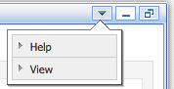
Portlets
Portlet : A rectangular bloc which allows to access to a content or a service.
Each portlet has some preferences, settings and decorations.
The portlet can be positioned in any place of a page.
You can reuse the same portlet several times: Then we say there are several instances of the same portlet.
Each instance of the same portlet can be configured differently.
Window decoration (optional)
Window states: maximized, minimized
Portlet Modes: view, edit, help
The combination of a portlet instance + preferences + decorations is also called an “application”.
Notes:
34

Slide 35
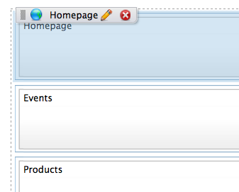
Portlet Preferences and Settings
In the page layout, hover of the portlet and click on the pencil.
Access to the preferences and settings
Notes:
35

Slide 36
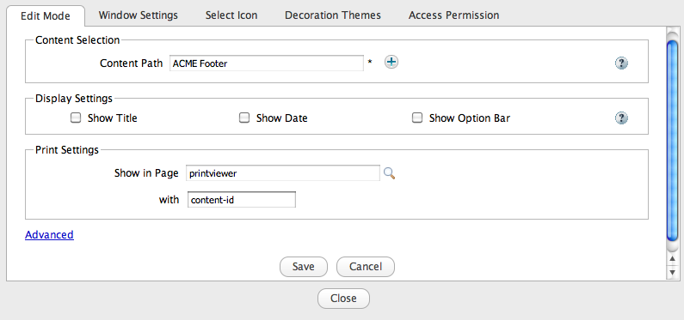
Portlet Preferences and Settings
The first tab (Edit Mode) depends on the portlet, therefore it’s different for each portlet. This tab is optional.
Notes:
36

Slide 37
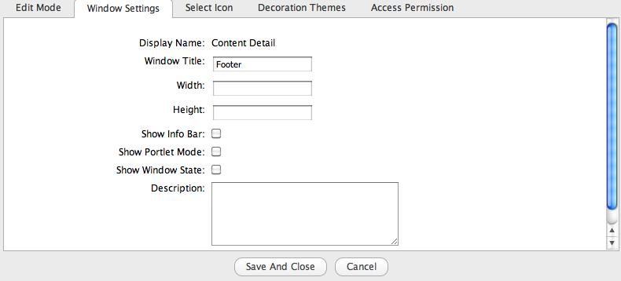
Portlet Preferences and Settings
Check if you need decorations. You can uncheck this by default at the site options.
Notes:
37

Slide 38
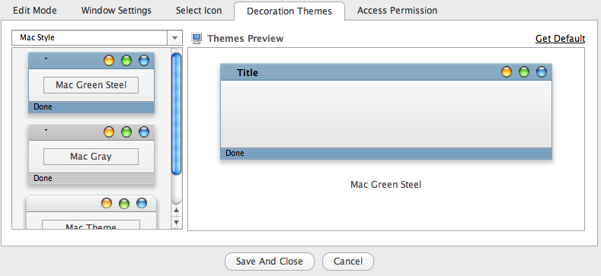
Portlet Preferences and Settings
Notes:
38

Slide 39
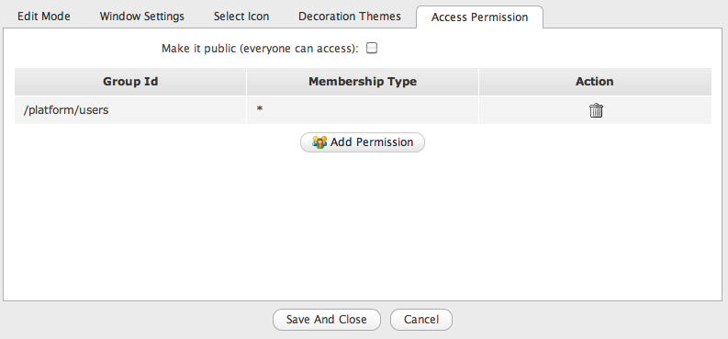
Portlet Preferences and Settings
Notes:
39

Slide 40
Navigation Nodes
Pointing to Pages

Slide 41
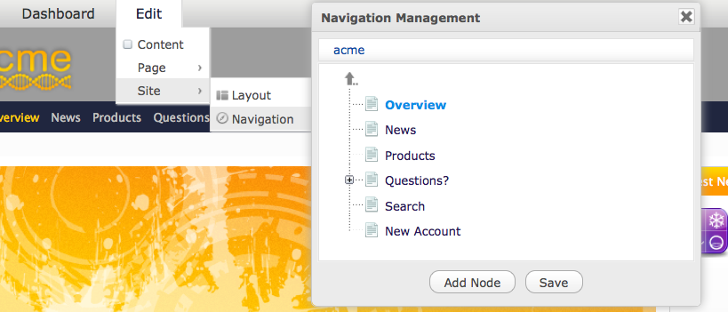
Navigation
Manage access to portal pages
Hierarchy structure of navigation nodes
Each node references a page
Aggregation types: site, group, user
Navigation portlet: Represents the navigation in a menu
Notes:
41

Slide 42
Navigation
Open navigation management of the current site
Visible navigation nodes of acme
Visible navigation nodes of acme
Invisible navigation nodes of acme
Notes:
42

Slide 43
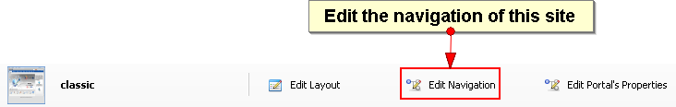
Navigation
Notes:
43

Slide 44
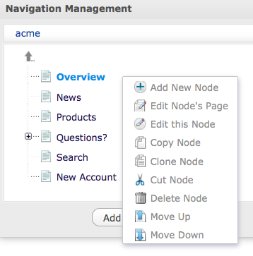
Navigation
Parent node
Right click
Navigation node modification
Invisible nodes
Notes:
44

Slide 45
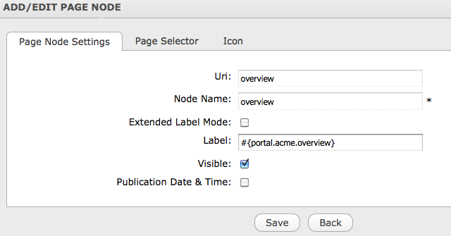
Navigation
Used in the URL
Notes:
45

Slide 46
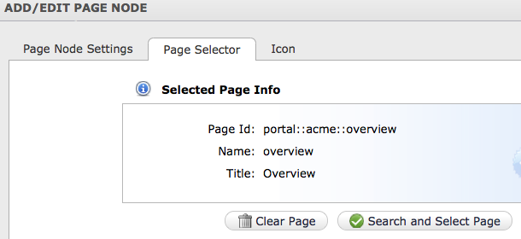
Navigation
Each navigation node is assigned to a page.
You create a new page or select an existing one.
You can point to same page from different navigation nodes.
Notes:
46

Slide 47
Portal Summary
A portal is a set of pages and navigations and some properties.
A page is a set of containers, applications and some properties.
A container can contain applications and/or other containers.
The navigation is node based.
A page can be referenced by many navigation nodes.
Notes:
47

Slide 48
Exercise 1/2: Site Navigation (15 min)
Create a new page, find it in the navigation and create new navigation
New Site Page
Login as John.
Open a site page.
Click on “Add new page” and browse to the root of the navigation (green arrow).
Add at least one application to the page (otherwise it won’t show up). Save.
Site Navigation
Click on “Site” in the Admin Tool Bar and open the navigation of your site.
Verify the existence of your new navigation node and page.
Notes:
48

Slide 49
Exercise 2/2: Site Navigation
Create a small navigation tree that reuses pages
Each page contains an IFrame portlet configured to show a target site.
Create the new pages “exoBlog” (http://blog.exoplatform.com/), “exoHome” (http://www.exoplatform.com/).
The navigation nodes “shortcuts”, “blog” and “eXo” nodes shall reference to the same page “exoBlog”.
Create the following user navigation:
eXo
Blog
eXo Home
Note that several navigation nodes can point to the same page.
Your marketing boss ask to change the navigation:
Interchange the order of the subtrees eXo and Shortcuts
Cut and paste “eXo Home” from “eXo” to “ShortCuts”.
Notes:
49

Slide 50
Application Registry
Portlets and Gadgets Administration

Slide 51
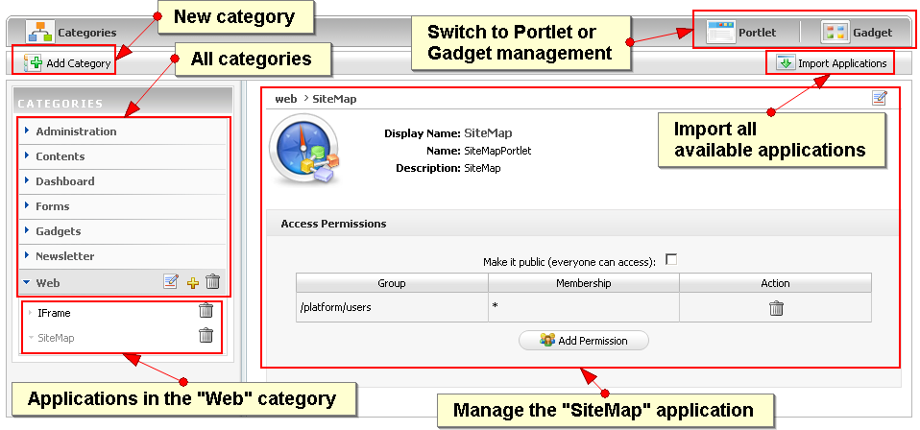
Application Registry
An application can be a portlet or a gadget.
Notes:
51

Slide 52
Application Registry
In the registry you can configure which applications are available to the users.
The available applications appear in the page and portal layout dialogs.
You can define access permission on category level and for each application.
The user only sees those applications where permissions in both levels are granted.
Notes:
52

Slide 53
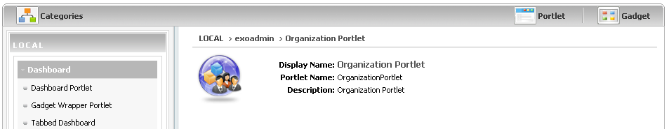
Application Registry
Portlets
Notes:
53

Slide 54
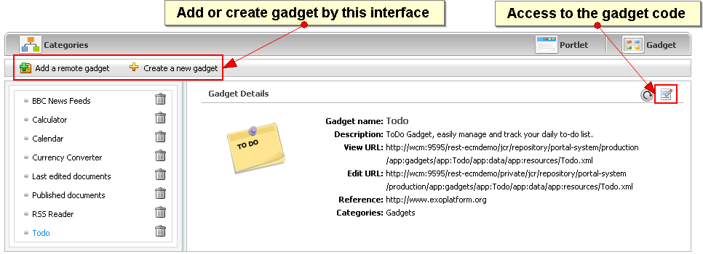
Application Registry
Gadgets
Can be loaded, created and modified.
Notes:
54

Slide 55
Exercise 1/2: Application Registry (20 min)
Import
Import all applications
Create a new application category “Bike Applications”.
Add some applications to your category.
Make your category accessible to all users.
Gadget
Switch to the Gadget panel. Create a new gadget.
Modify the gadget code by replacing “hello world” by “toto”. Save and add it to your new category.
Layout
Create a test page, open the layout and test the new category and applications.
Notes:
55

Slide 56
Exercise 2/2: Application Registry
Permissions
Create an application category only accessible for the group “organization/management”.
Open an application in a public category and make it visible only to the management, put this application into a category available to all users.
Login as “elena”,
Click on dashboard
Add new page. Check if there are categories and application that are only accessible to the management.
Logout, login as john, put “elena” in the “organization/management” group
Click on dashboard
Add new page. Check if there are categories and application that are only accessible to the management.
Notes:
56

Slide 57
Group Sites and Navigation
Groups Sites and Navigations

Slide 58
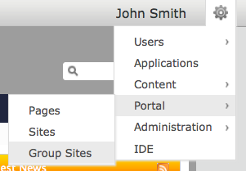
Groups
There can be a portal for each group. Portal = layout + pages + navigation
Each user belongs to one or several groups.
You see the navigations and pages of your groups in the Admin Tool Bar.
Only those users with the role “manager” can modify the navigation of a group.
Click!
Notes:
58

Slide 59
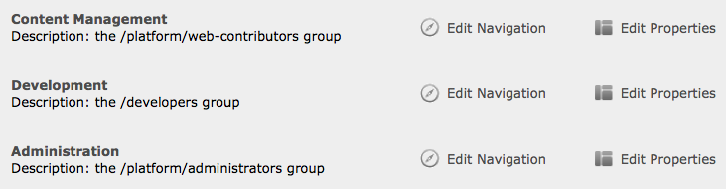
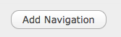
Groups
You see all groups where you have the “manager” role, but only those which already have navigation.
You can add new navigations for groups where have the “manager” role.
Group with navigation and where the connected user has the role “manager”
Add a group to this list that does not have navigation nodes yet.
Notes:
59

Slide 60
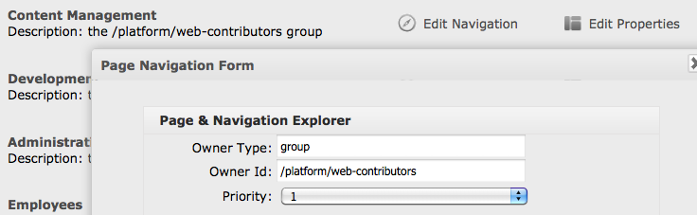
Groups
By clicking on “Edit Properties” you can define the order of the group navigations in the menu.
Notes:
60

Slide 61
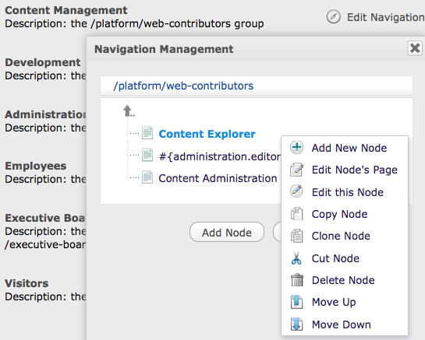
Group Navigation
Navigation of the group Content Management
Notes:
61

Slide 62
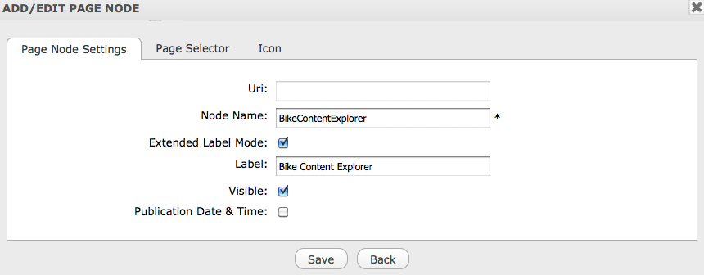
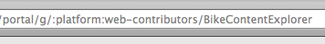
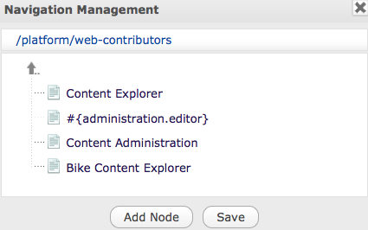
Group Navigation
The node name is part of the URL
New navigation node
Notes:
62

Slide 63
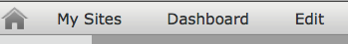


Group Navigation
Admin Tool Bar entries before adding a first group navigation node
Other navigation nodes of the group “Content Management”
This new entry appears with the first node
New navigation node
Notes:
63

Slide 64
Exercise: Group Site 1/2 (15 min)
Create a new page in a group, create pages accessible for platform/bike only, modify the layout of this group’s pages.
New Group Page
Login as John. Open a group page of platform/administrators. (Add User)
Click on “Add new page” and browse to the root of the group navigation (green arrow).
Add at least one application to the page (otherwise it won’t show up). Save.
Notes:
64

Slide 65
Exercise: Group Site 2/2
Groups Navigation
Click on “Manage Groups” in the Admin Tool Bar and open the navigation of platform/administrators.
Verify the existence of your new navigation node and page.
Make john a manager of the group “platform/bike”. Add a navigation to the group platform/bike. Add two new navigation nodes to the group, select any existing page or create new pages.
Group Layout
Click on a page of “platform/administrator and modify the portal layout for all pages of this group (“Edit Layout”).
Modify also the layout of the platform/bike group portal.
Switch between the pages of the different groups in order to experience the differences.
Notes:
65

Slide 66
Examples

Slide 67


Slide 68


Slide 69


Slide 70


Slide 71
Portal Advanced Features
Sites, Layouts, Navigation, Portlets

